Slide 1
SLISEMAP Combining supervised dimensionality reduction with local explanations
Björklund, A., Mäkelä, J., Puolamäki, K., 2022. SLISEMAP: Supervised dimensionality reduction through local explanations. arXiv:2201.04455 [cs]. https://arxiv.org/abs/2201.04455
Anton Björklund & Jarmo Mäkelä & Kai Puolamäki
https://github.com/edahelsinki/slisemap
pip install slisemap
9 May 2022
Notes:
I will now present SLISEMAP: our new supervised dimensionality reduction method that can be used to explain black box classification or regression models. SLISEMAP is open source and available as a Python library via GitHub.

Slide 2
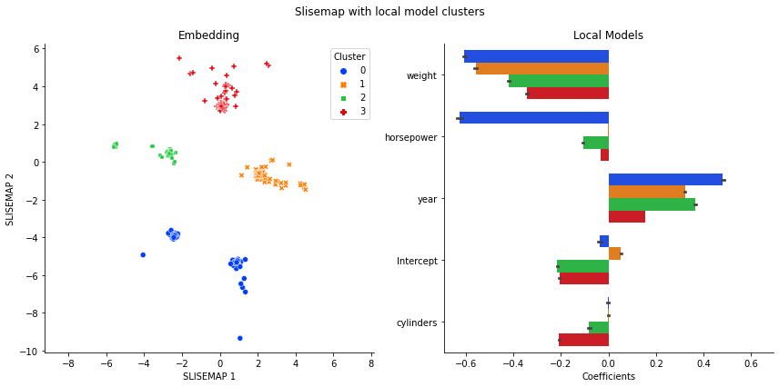
What is SLISEMAP?
n datapoints
input
which are real vectors
black box global model
white box local models
output
2D embedding of datapoints
Notes:
What is SLISEMAP?
SLISEMAP is a supervised dimensionality reduction method that can be used to explain black box regression and classification models.
With SLISEMAP we can visualise the data structures that are relevant to the black box models.
At the same time, SLISEMAP gives understandable local explanations for the predictions of the black box models.
Combined, the visualisation and local explanations form a global explanation of the black box models.
SLISEMAP visualises data by a typically 2-dimensional embedding.
The embedding is such that nearby points have similar explanations.
A local explanation consists of an understandable white box model that locally approximates the predictions of the black box model.
In this SLISEMAP is similar to how other local explanation methods work.
SLISEMAP takes as an input data vectors and predictions from a black box model.
SLISEMAP produces an embedding of data points and a white box model for each of the data points.
In the embedding, nearby points have similar white box models.

Slide 3
n datapoints
input
which are real vectors
complex regression or
classification function
black box global model f
simple understandable
functions
white box local models g_{i}
output
2D embedding z_{i} of datapoints
Optimization criteria for a solution:
Nearby points i and j in the embedding is
explained by the same white box model or f(x_{i}) ≈g_{j}(x_{i}).
Notes:
This optimisation problem is difficult.
SLISEMAP solves it by efficient heuristics and by using PyTorch library for optional GPU acceleration.

Slide 4
Basic SLISEMAP usage
pip install slisemap
Notes:
Here we can see the basic usage of the SLISEMAP library: we create a SLISEMAP object, find a solution, and visualise it.

Slide 5
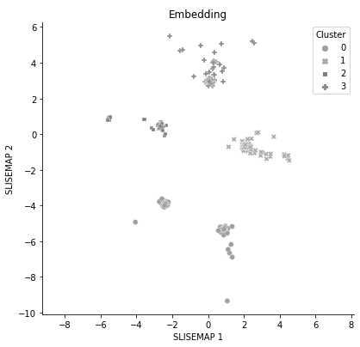
SLISEMAP embedding and local models
autompg
dataset &
random forest
regressor
Notes:
Here we demonstrate SLISEMAP on the Auto MPG dataset.
We use a random forest as the black box model to predict the fuel efficiency of the cars.
For the local models we use linear regression.
The embedding created by SLISEMAP contains a clear cluster structure.

Slide 6
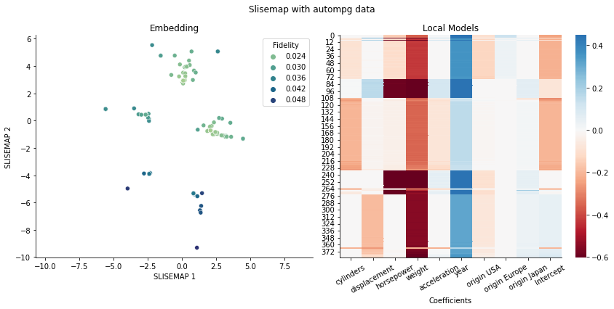
SLISEMAP embedding and local models
autompg
dataset &
random forest
regressor
Notes:
Each point in the embedding has a corresponding linear regression model.

Slide 7
SLISEMAP embedding and local models
autompg
dataset &
random forest
regressor
Notes:
To make the interpretation easier, we have clustered the regression coefficients into four clusters.
The cluster indices are shown with distinct colours.
On the right, we have the mean regression coefficients for each of the local model clusters.
We show only the five most important variables.
We can take any data point and multiply its data vector with the coefficients of any of the local models from the same cluster.
This gives a good fidelity estimate of the random forest prediction.

Slide 8
Optimization criteria for a solution:
Nearby points i and j in the embedding is
explained by the same white box model or f(x_{i}) ≈g_{j}(x_{i}).
here white box
local model g_{i} is
linear regression
here black box
global model f is
random forest
regression
Notes:
Lets take a closer look at cluster 3, coloured red.
Cluster 3 consists mostly of slightly older US-made cars, which perform poorly in fuel economy.
The random forest primarily uses the weight of the car to predict the fuel consumption in this cluster.
Horsepower is not used for this cluster, but it is an important variable for other clusters.
Please see the Jupyter notebook on GitHub for more details.

Slide 9
SLISEMAP Combining supervised dimensionality reduction with local explanations
Björklund, A., Mäkelä, J., Puolamäki, K., 2022. SLISEMAP: Supervised dimensionality reduction through local explanations. arXiv:2201.04455 [cs]. https://arxiv.org/abs/2201.04455
Anton Björklund & Jarmo Mäkelä & Kai Puolamäki
https://github.com/edahelsinki/slisemap
pip install slisemap
9 May 2022
Notes:
You can download the Python package and illustrative notebooks from GitHub, or read our arXiv publication for in-depth treatment of SLISEMAP.
Thank you for your time and interest.

